Slide 1

-Digital Control Term Project Report- Simulation of a Wind Turbine Emulator System
Team Member : Chung-En Liu、Li-Yang Chang
Professor : Feng-Li Lian
Date : 2019/6/25
National Taiwan University Department of Electrical Engineering

Slide 2
Introduction
Wind turbine emulators (WTE) simulate the dynamic performances of a wind turbine
A WTE usually consists of：
DC motor：
Simulates the torque of the blades induced by wind
Both [1: Jayati Dey et al. 2014] and [5: S. Kouadriaet al. 2013] have proposed control systems for controlling the output torque of a DC motor.
Mathematical model：
To observe the characteristics of a wind turbine
Both [2: J. Vaheeshan et al. 2011] and [3: Baozhong Liu et al. 2014] have introduced mathematical models for wind turbines
By using Simulink, we have constructed a system that is capable of controlling the output speed of a DC motor in a WTE. The system is based on the system proposed in [1: Jayati Dey et al. 2014].

Slide 3
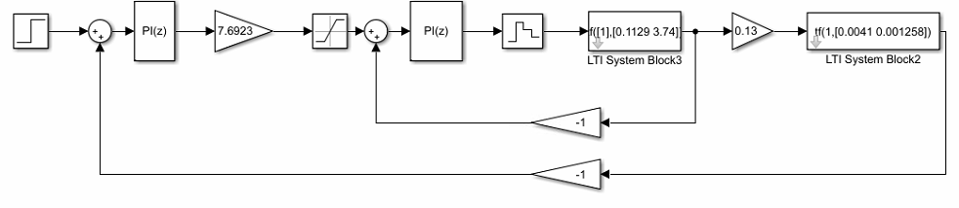

Digital control scheme of the system
The system consists of：
Motor Plant (continuous)
Speed controller (discrete)
Current controller (discrete)
The system tracks the reference rotation speed of the motor, $w_{ref}$.
A step function with values 500 and 1000 are given as the reference rotation speed.
Fig. 1 Overall Control System of the DC motor

Slide 4
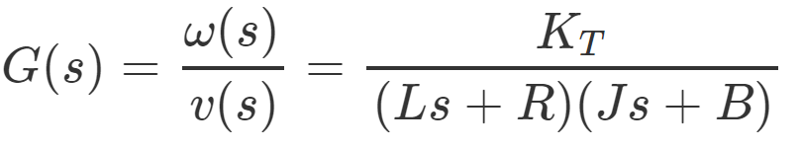







Transfer function & State-space
Eqn. (1) indicates the transfer function of the CT plant
Values and meanings for the notations in Eqn. (1) are as follows:
Torque Constant $K_{T}=0.13 Nm/Amp$
Armature Inductance $L=112.9 mH$
Armature Resistance $R=3.74 Ω$
Motor Inertia $J=0.0041 Kg−m^{2}$
Motor Damping Constant $B=0.001258 Nm∗sec/rad$
The tf2ss() function in Matlab allows us to convert the transfer function of the plant to it’s state-space. Eqn. (2) shows the result we get.
$$A=\left[\begin{matrix}−33.435 & −10.1642 \\ 1 & 0\end{matrix}\right]$$
$$\dot{x}\left(t\right)=Ax\left(t\right)+Bu\left(t\right)$$
$$B=\left[\begin{matrix}1 \\ 0\end{matrix}\right]$$
$$y\left(t\right)=Cx\left(t\right)+Du\left(t\right)$$
$$C=\left[\begin{matrix}0 & 280.8443\end{matrix}\right]$$
$$D=0$$
Eqn. (1) Transfer function of the CT plant
Eqn. (2) State-space of the CT plant

Slide 5

Controllability and Observability
With the state-space of the plant, we could calculate the controllability matrix and observability matrix of the system.
We calculate the controllability matrix with ctrb() function in Matlab
$W_{C}=\left[\begin{matrix}1 & −33.4335 \\ 0 & 1\end{matrix}\right]$
$W_{C}$ has full rank the system is controllable
We calculate the controllability matrix with obsv() function in Matlab
$W_{O}=\left[\begin{matrix}0 & 280.8443 \\ 280.8443 & 0\end{matrix}\right]$
$W_{O}$has full rank the system is observable

Slide 6
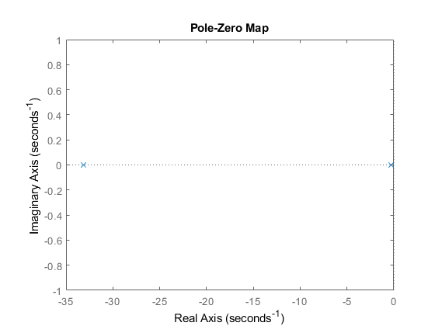
Poles and Zeros
From the transfer function of the system, we get
Poles : -33.1267 and -0.3068
Zeros: None
Using the pzplot() function in Matlab, we can double check the answer. As shown in Fig. 2, there are only two poles in the pole-zero map.
Eqn. (1) Transfer function of the CT plant
Fig. 2 Pole-Zero Map plot by Matlab

Slide 7
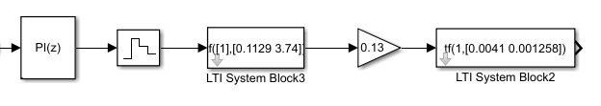
DT plant
The discrete signal output of the current controller (DT plant) becomes continuous after passing a zero-order hold block.
The red circle in Fig. 2 indicates the zero-order hold block.
We then design our DT controllers for the DT plant.
Fig. 2 Simulation of the DT plant in Simulink

Slide 8
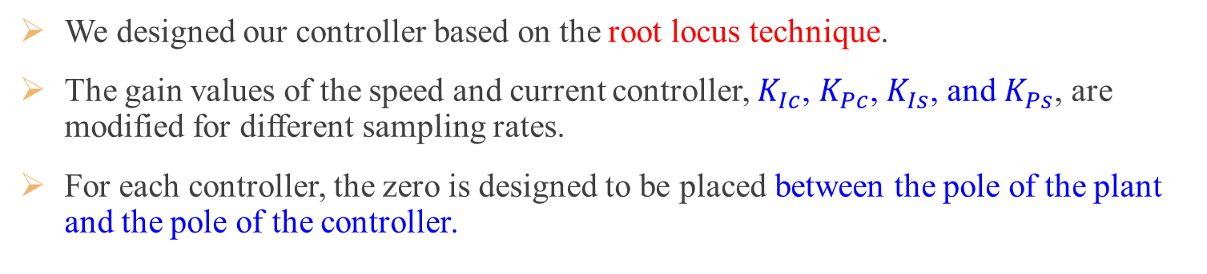
Discrete Controller Design
We designed our controller based on the root locus technique.
The gain values of the speed and current controller, $K_{Ic}$, $K_{Pc}$, $K_{Is}$, and $K_{Ps}$, are modified for different sampling rates.
For each controller, the zero is designed to be placed between the pole of the plant and the pole of the controller.
Fig. 3 The speed controller is highlighted in a red box and the current controller is highlighted in a blue box.

Slide 9





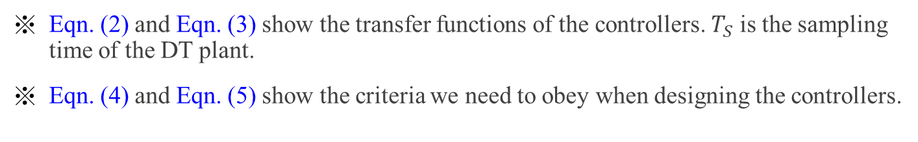

Discrete Controller Design
For current controller :
$zero=−\frac{K_{Ic}}{K_{Pc}}$ (subscript c stands for current)
$pole of the plant=−\frac{R}{L}=−33.1267$
$pole of the controller=origin$
For speed controller :
$zero=−\frac{K_{Is}}{K_{Ps}}$ (subscript s stands for speed)
$pole of the plant=−\frac{B}{J}=−0.3068$
$pole of the controller=origin$
$$C_{c}\left(Z\right)=K_{Pc}+K_{Ic}\frac{T_{s}z}{z−1}$$
$$C_{s}\left(Z\right)=K_{Ps}+K_{Is}\frac{T_{s}z}{z−1}$$
Eqn. (2) Transfer function of the current controller
Eqn. (3) Transfer function of the speed controller
$$0<\frac{K_{Ic}}{K_{Pc}}<33.1267$$
$$0<\frac{K_{Is}}{K_{Ps}}<0.3068$$
Eqn. (4) Criterion for the current controller
Eqn. (5) Criterion for the speed controller
Eqn. (2) and Eqn. (3) show the transfer functions of the controllers. $T_{S}$ is the sampling time of the DT plant.
Eqn. (4) and Eqn. (5) show the criteria we need to obey when designing the controllers.

Slide 10
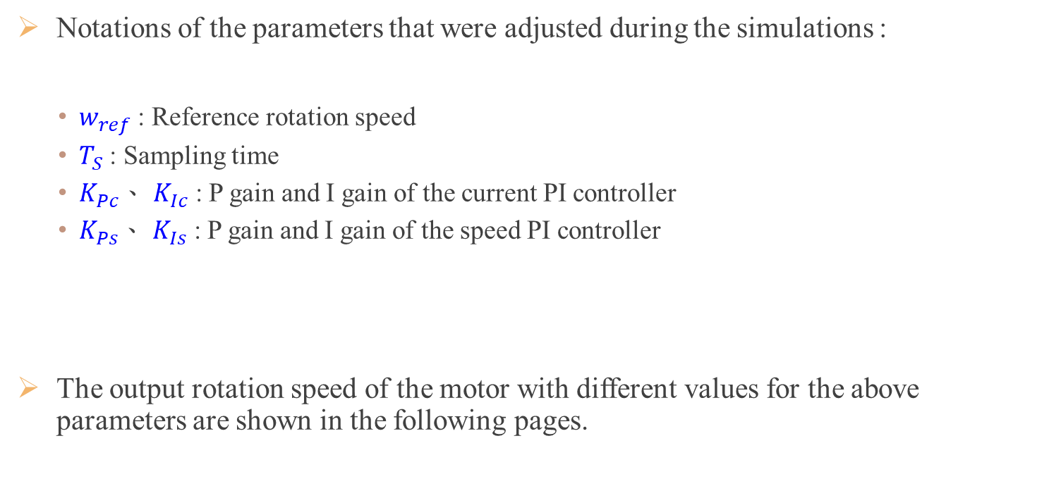
Introduction on notations
Notations of the parameters that were adjusted during the simulations :
$w_{ref}$ : Reference rotation speed
$T_{S}$ : Sampling time
$K_{Pc}$、 $K_{Ic}$ : P gain and I gain of the current PI controller
$K_{Ps}$、 $K_{Is}$ : P gain and I gain of the speed PI controller
The output rotation speed of the motor with different values for the above parameters are shown in the following pages.

Slide 11
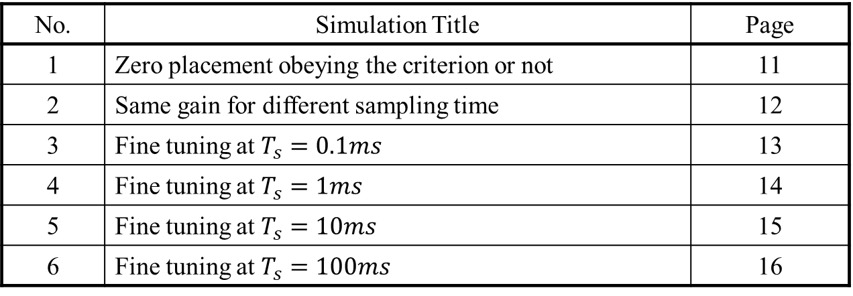
Simulation
The following simulations are done to test if the speed controller and current controller have been set correctly.
Fine tuning is also performed for 4 different sampling times.
Ideally, the controllers should be capable of tracking the reference speed values as quick as possible. Namely, within 1 second.
Table. 1 Full list of the simulations on testing the speed controller and current controller
No. | Simulation Title | Page
1 | Zero placement obeying the criterion or not | 11
2 | Same gain for different sampling time | 12
3 | Fine tuning at $T_{s}=0.1ms$ | 13
4 | Fine tuning at $T_{s}=1ms$ | 14
5 | Fine tuning at $T_{s}=10ms$ | 15
6 | Fine tuning at $T_{s}=100ms$ | 16

Slide 12
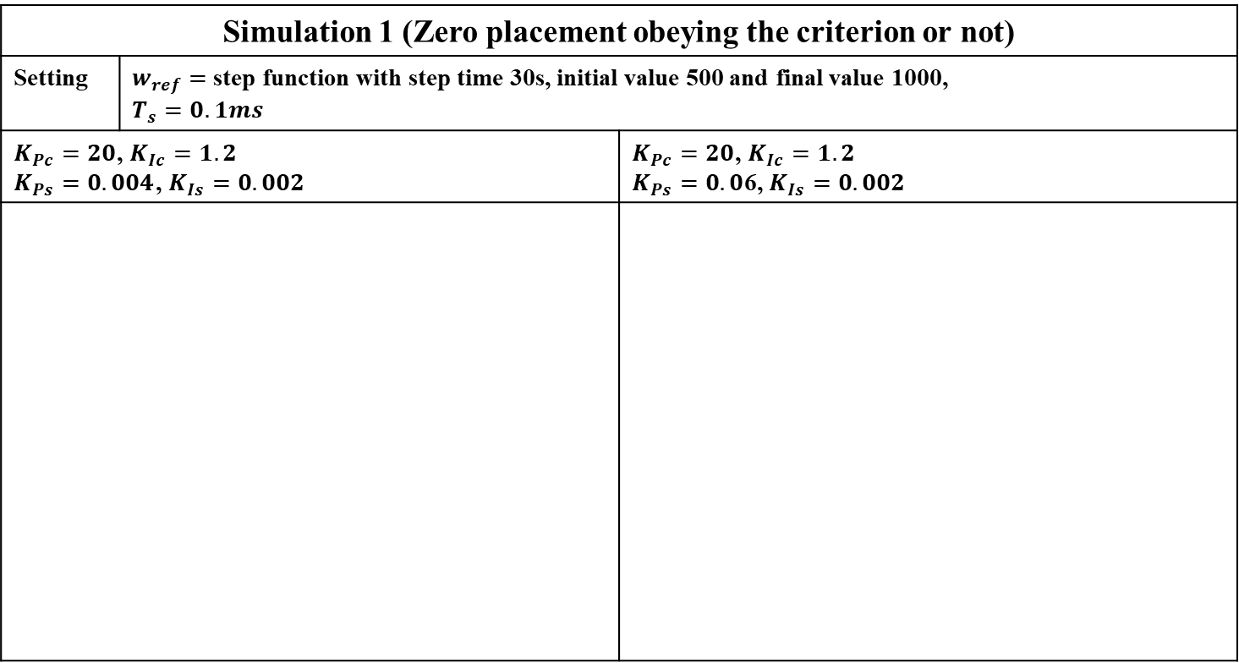
Simulation results
Simulation 1 (Zero placement obeying the criterion or not)
Setting | $w_{ref}=$ step function with step time 30s, initial value 500 and final value 1000, $$T_{s}=0.1ms$$
$K_{Pc}=20$, $K_{Ic}=1.2$ $K_{Ps}=0.004$, $K_{Is}=0.002$ |  | $K_{Pc}=20$, $K_{Ic}=1.2$ $K_{Ps}=0.0$6, $K_{Is}=0.002$
Fig. 4
The result when the criterion is obeyed
Fig. 5
The result when the criterion is violated
Violating the criterion when designing the controllers result in an overshoot. An overdamped response is then unobservable.

Slide 13
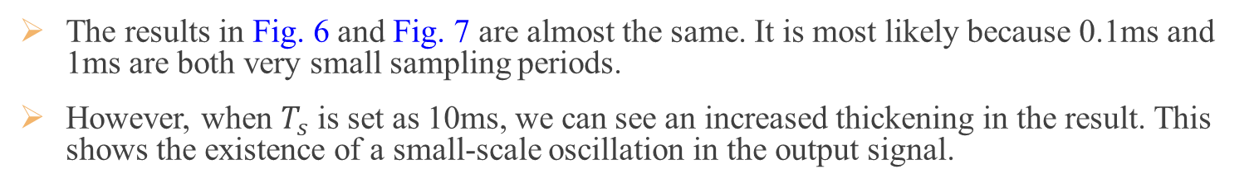
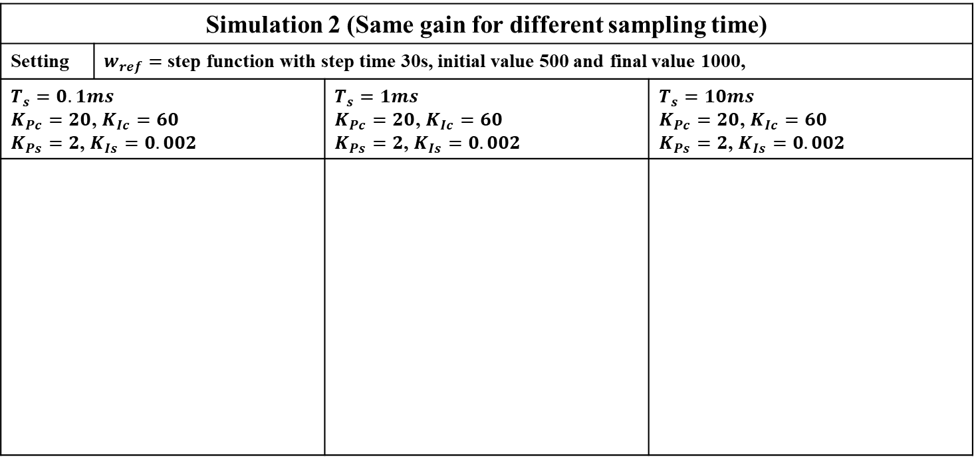



Simulation results
Simulation 2 (Same gain for different sampling time)
Setting | $w_{ref}=$ step function with step time 30s, initial value 500 and final value 1000,
$$T_{s}=0.1ms$$ $K_{Pc}=20$, $K_{Ic}=60$ $K_{Ps}=2$, $K_{Is}=0.002$ |  | $$T_{s}=1ms$$ $K_{Pc}=20$, $K_{Ic}=60$ $K_{Ps}=2$, $K_{Is}=0.002$ | $$T_{s}=10ms$$ $K_{Pc}=20$, $K_{Ic}=60$ $K_{Ps}=2$, $K_{Is}=0.002$
Fig. 6
The result when $T_{s}=0.1ms$
Fig. 7
The result when $T_{s}=1ms$
Fig. 8
The result when $T_{s}=10ms$
The results in Fig. 6 and Fig. 7 are almost the same. It is most likely because 0.1ms and 1ms are both very small sampling periods.
However, when $T_{s}$ is set as 10ms, we can see an increased thickening in the result. This shows the existence of a small-scale oscillation in the output signal.

Slide 14
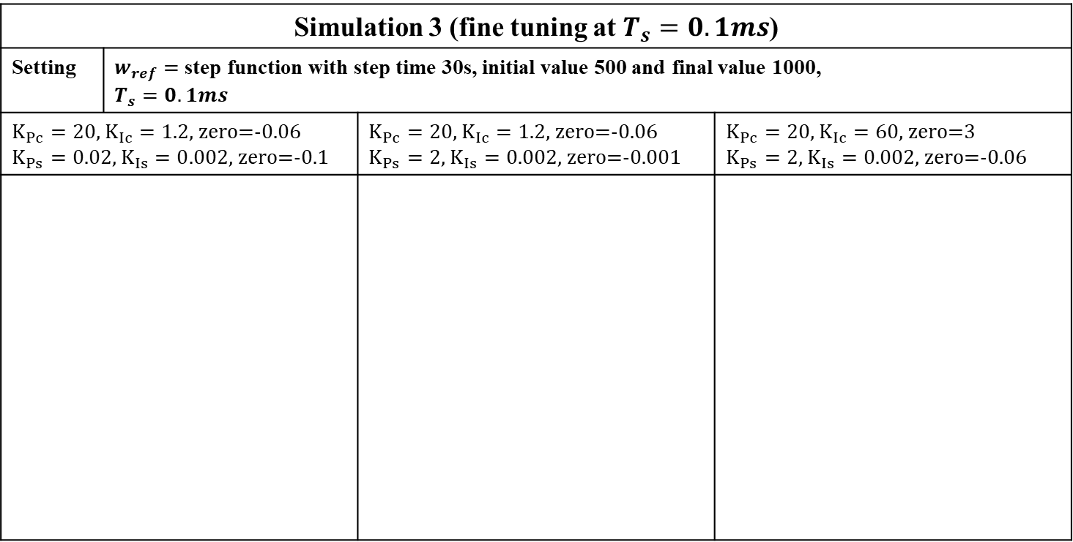
Simulation results
Simulation 3 (fine tuning at $T_{s}=0.1ms$)
Setting | $w_{ref}=$ step function with step time 30s, initial value 500 and final value 1000, $$T_{s}=0.1ms$$
$K_{Pc}=20$, $K_{Ic}=1.2$, zero=-0.06 $K_{Ps}=0.02$, $K_{Is}=0.002$, zero=-0.1 |  | $K_{Pc}=20$, $K_{Ic}=1.2$, zero=-0.06 $K_{Ps}=2$, $K_{Is}=0.002$, zero=-0.001 | $K_{Pc}=20$, $K_{Ic}=60$, zero=3 $K_{Ps}=2$, $K_{Is}=0.002$, zero=-0.06
Fig. 9
The result with initial guess
Fig. 10
The result after changing the gain of the speed controller
Fig. 11
The result after changing the gain of the current controller
After tuning the gain of the controllers several times, we can see the improvement in the tracking ability. The system is now able to track the reference speed faster and more accurate.

Slide 15
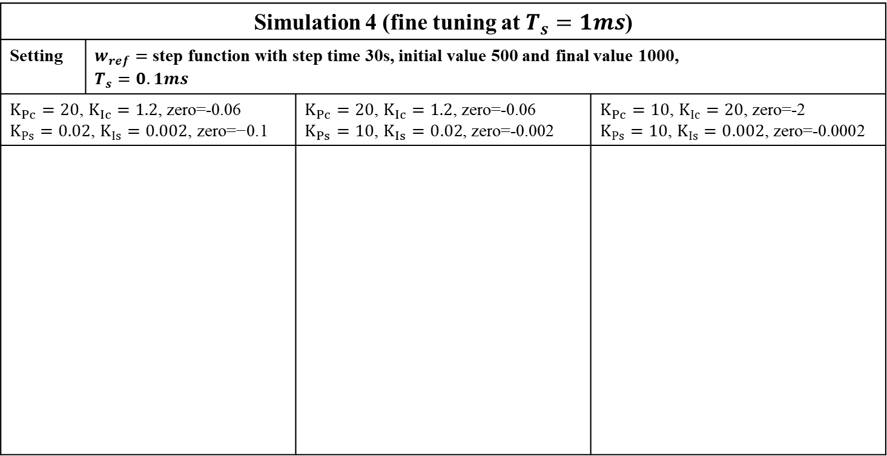
Simulation results
Simulation 4 (fine tuning at $T_{s}=1ms$)
Setting | $w_{ref}=$ step function with step time 30s, initial value 500 and final value 1000, $$T_{s}=0.1ms$$
$K_{Pc}=20$, $K_{Ic}=1.2$, zero=-0.06 $K_{Ps}=0.02$, $K_{Is}=0.002\text{, }\text{zero}\text{=−0.1}$ |  | $K_{Pc}=20$, $K_{Ic}=1.2$, zero=-0.06 $K_{Ps}=10$, $K_{Is}=0.02$, zero=-0.002 | $K_{Pc}=10$, $K_{Ic}=20$, zero=-2 $K_{Ps}=10$, $K_{Is}=0.002$, zero=-0.0002
Fig. 12
The result with initial guess
Fig. 13
The result after changing the gain of the speed controller
Fig. 14
The result after changing the gain of the current controller
The results of sampling time 1ms is similar to the results of sampling time 0.1ms. This is probably because both sampling times are small.

Slide 16
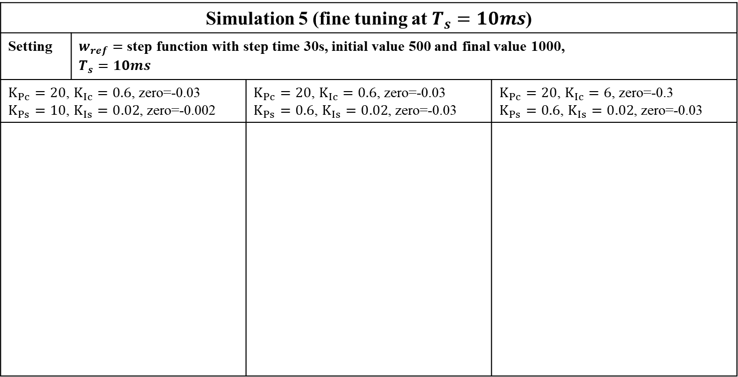
Simulation results
Simulation 5 (fine tuning at $T_{s}=10ms$)
Setting | $w_{ref}=$ step function with step time 30s, initial value 500 and final value 1000, $$T_{s}=10ms$$
$K_{Pc}=20$, $K_{Ic}=0.6$, zero=-0.03 $K_{Ps}=10$, $K_{Is}=0.02$, zero=-0.002 |  | $K_{Pc}=20$, $K_{Ic}=0.6$, zero=-0.03 $K_{Ps}=0.6$, $K_{Is}=0.02$, zero=-0.03 | $K_{Pc}=20$, $K_{Ic}=6$, zero=-0.3 $K_{Ps}=0.6$, $K_{Is}=0.02$, zero=-0.03
Fig. 15
The result with initial guess
Fig. 16
The result after changing the gain of the speed controller
Fig. 17
The result after changing the gain of the current controller
The system becomes more stable in steady state after lowering the P gain in the speed controller.
However, overshoot occurs after increasing the I gain in the current controller.

Slide 17
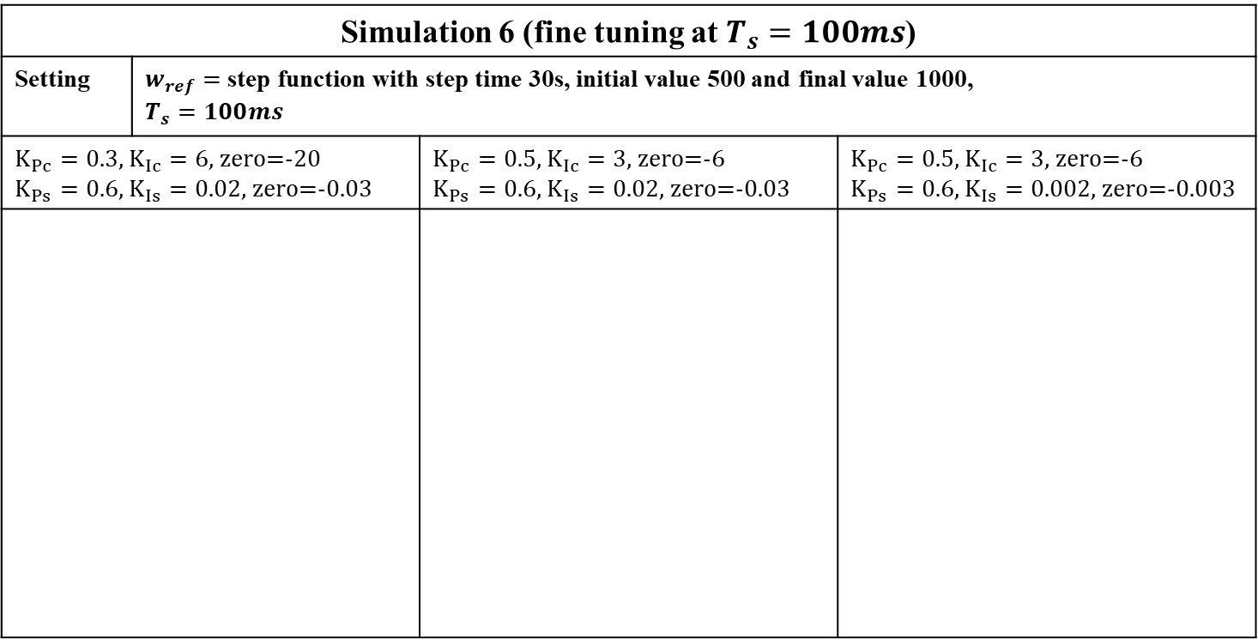
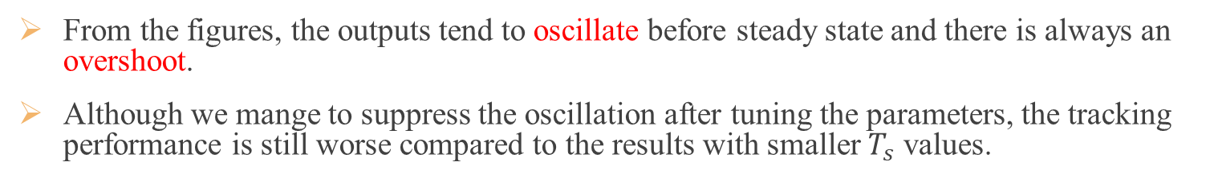
Simulation results
Simulation 6 (fine tuning at $T_{s}=100ms$)
Setting | $w_{ref}=$ step function with step time 30s, initial value 500 and final value 1000, $$T_{s}=100ms$$
$K_{Pc}=0.3$, $K_{Ic}=6$, zero=-20 $K_{Ps}=0.6$, $K_{Is}=0.02$, zero=-0.03 |  | $K_{Pc}=0.5$, $K_{Ic}=3$, zero=-6 $K_{Ps}=0.6$, $K_{Is}=0.02$, zero=-0.03 | $K_{Pc}=0.5$, $K_{Ic}=3$, zero=-6 $K_{Ps}=0.6$, $K_{Is}=0.002$, zero=-0.003
Fig. 17
The result with initial guess
Fig. 18
The result after changing the gain of the current controller
Fig. 19
The result after changing the gain of the speed controller
From the figures, the outputs tend to oscillate before steady state and there is always an overshoot.
Although we mange to suppress the oscillation after tuning the parameters, the tracking performance is still worse compared to the results with smaller $T_{s}$ values.

Slide 18
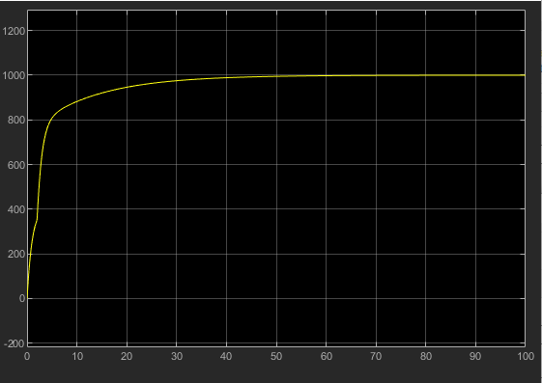
Improvements
Before tuning the discrete controllers individually, we obtained terrible results as shown in Fig. X. It took nearly 60 seconds to track the reference speed 1000 rpm.
After fine tuning, we are now able to track the reference speed within 1.5 seconds.
It is also noticeable that reference speed 500 is tracked quicker than reference speed 1000. Our guess is that higher reference speed requires more time to track.
Our tuned results are still incapable of tracking all reference speed within 1 sec.
Fig. 17 Results before individual gain tuning.
Fig. 17 Results after individual gain tuning.
Notes:
Helps me in understanding the paper

Slide 19
Conclusion
The values provided by the paper did not provide us promising results. Additional and individual tuning on the PI controllers are mandatory.
Smaller sampling rates are easier to tune. The results are also better compared to higher sampling rates.
The smaller the sampling rates, the more a discrete plant can be viewed as a continuous plant.
As the controller and plant poles are placed according to the motor ratings, controller and plant poles should be updated when considering different motors.
From the speed controller zero placements, it is easily seen that the closer the zero is placed near the controller pole, the quicker and more accurate the reference is tracked.
As for current controller zero placements, when the zero is placed near the plant pole, it is observable that the underdamping and overdamping effects are cancelled off.
Overall, the speed controller zero placements need to be near the controller pole, while the current controller need to be placed near the plant pole.
Notes:
Helps me in understanding the paper

Slide 20
Reference
[1: Jayati Dey et al. 2014]
Jayati Dey, Tapas Kumar Saha, Jitesh Chandra Barman, “Performance analysis of a digitally controlled wind turbine emulator, ” International Conference on Electronics, Communication and Instrumentation (ICECI), 2014
[2: J. Vaheeshan et al. 2011]
J. Vaheeshan, V. Vihirthanath, S. G. Abeyaratne, A. Atputharajah, G. Ramatharan, “Wind Turbine Emulator, ” International Conference on Industrial and Information Systems, 2011
[3: Baozhong Liu et al. 2014]
Baozhong Liu , Fujio Tatsuta, Shoji Nishikata, Katsumi Suzuki, “A study on a wind turbine simulator with a DC motor considering various moments of inertia, ” International Conference on Electrical Machines and Systems (ICEMS), 2014
[4: Mohan Pavan Kumar Bailapudi et al. 2016]
Mohan Pavan Kumar Bailapudi, Nidul Sinha, “Fuzzy logic controlled wind turbine emulator (WTE),” International Conference on Information Communication and Embedded Systems (ICICES), 2016
[5: S. Kouadriaet al. 2013]
S. Kouadria, S. Belfedhal, E.M. Berkouk, Y. Meslem, “Development of real time wind turbine emulator based on DC motor controlled by PI regulator, ” Eighth International Conference and Exhibition on Ecological Vehicles and Renewable Energies (EVER), 2013
[6: Vo Thanh Ha et al. 2011]
Vo Thanh Ha, Vu Hoang Phuong, Nguyen Tung Lam, Nguyen Phung Quang, “A dead-beat current controller based wind turbine emulator, ” International Conference on System Science and Engineering (ICSSE), 2017
[7: Santaphon Kumsup et al. 2010]
Santaphon Kumsup, Chanrit Tarasantisuk, “Real-time wind turbine emulator for testing wind energy conversion systems, ” IEEE International Energy Conference, 2010
Notes:
Helps me in understanding the paper

